Slide 1



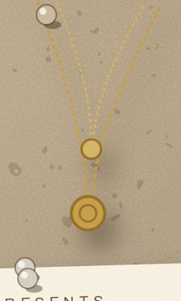


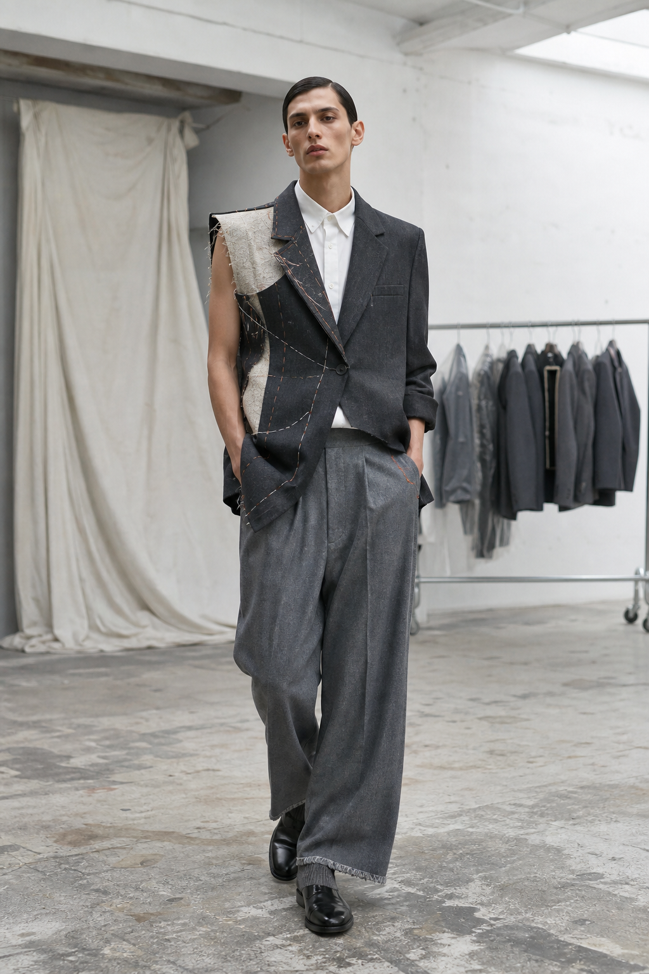





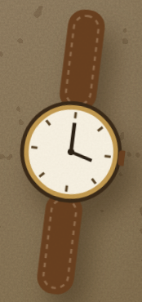

A COLLECTION PRESENTS
SEAM ALLOWANCE
Spring/Summer 2027
LOOKBOOK N.09
shot on the atelier table

Slide 2


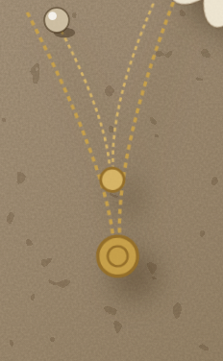

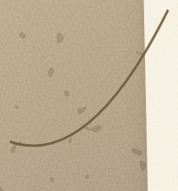


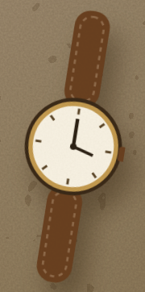
About the Maison
THE MAISON
SPRING/SUMMER 2027
THE ATELIER
A finished suit is a lie told very well — hours of labour hidden inside a clean surface. This collection takes the position that the seam allowance, the margin of cloth never meant to be seen, is the most honest part of the garment, and builds everything from it. Working exclusively with reclaimed suiting is not a sustainability badge but a design method: the constraints of deadstock cloth — fixed panel widths, existing shoulders, shade bands instead of dye lots — generate the silhouettes. And deconstruction here is not disorder; leaving an edge raw at exactly the right place, frayed to exactly the right depth, demands more precisi…
— The Maison
pinned to the wall since day one

Slide 3




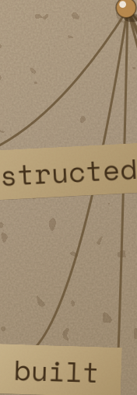
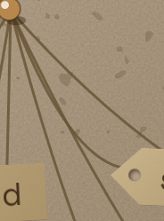
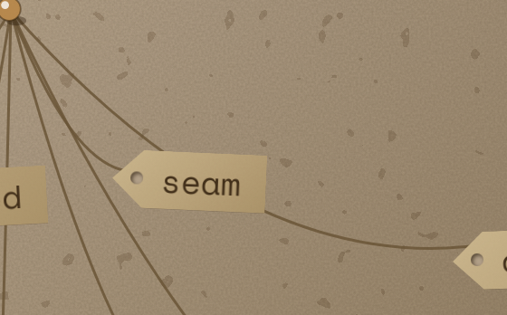
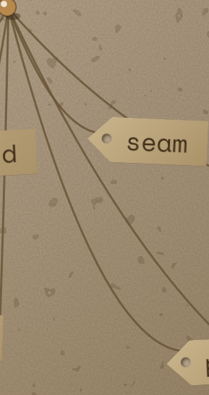
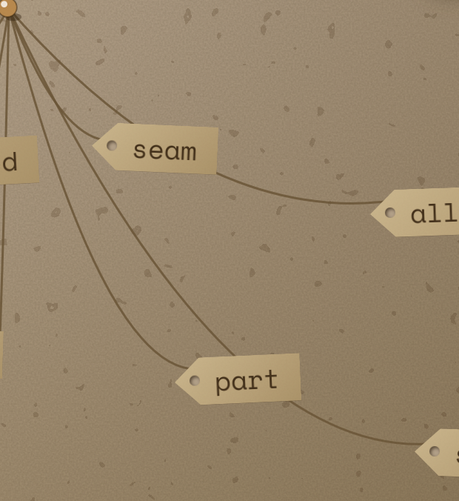

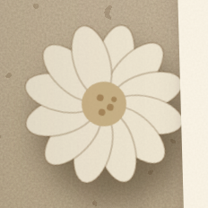
THEME
SEAM ALLOWANCE
deconstructed
seam
SEAM ALLOWANCE is built from the part of a suit nobody was ever meant to see — the hidden margin of cloth inside every seam, exposed and made load-bearing. Every garment is cut from reclaimed and deadstock suiting: donor jackets and trousers unpicked, re-blocked and reassembled with their construction left open — raw edges, floating half-canvases, visible basting. SS27 forecasting is clear that silhouette is moving away from extremes toward precision, and that surfaces are becoming more dimensional with construction more considered; this collection answers that with tailoring where the making is the decoration.…
allowance
built
part
suit
nobody
the mood, in seven words

Slide 4


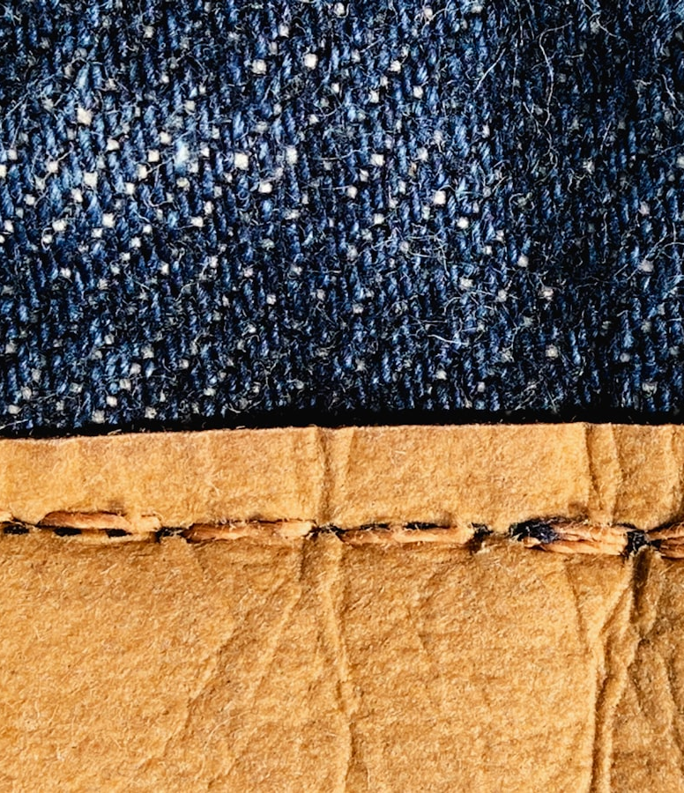


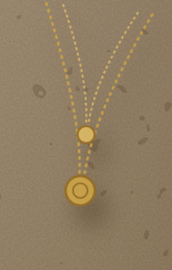
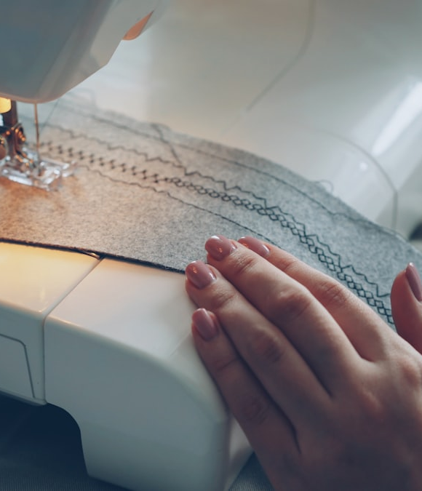

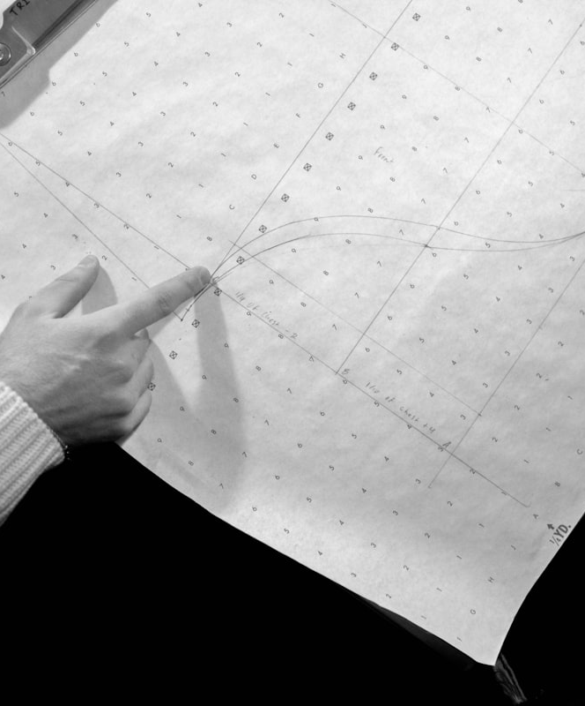

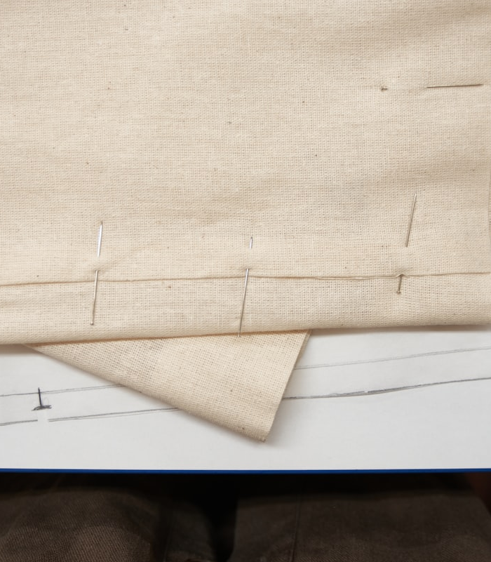


Inspiration
RESEARCH WALL
ph. Second Breakfast
ph. Marjan Taghipour
ph. Vitaly Gariev
ph. Matthew Moloney
FIELD NOTES
The lineage is the tailor's atelier at first-fitting stage — the moment a suit is still held together by basting thread and chalk, before anyone commits to finishing it — crossed with Margiela's Artisanal inside-out tailoring, A.W.A.K.E Mode's reassembled suiting, and the Japanese boro ethic where repair and reuse are the surface. SS27 forecasting sharpens the timing: silhouette is moving to precision over extremes, and surfaces are becoming dimensional w…
keep looking ↓
ph. Kristina Tochilko

Slide 5
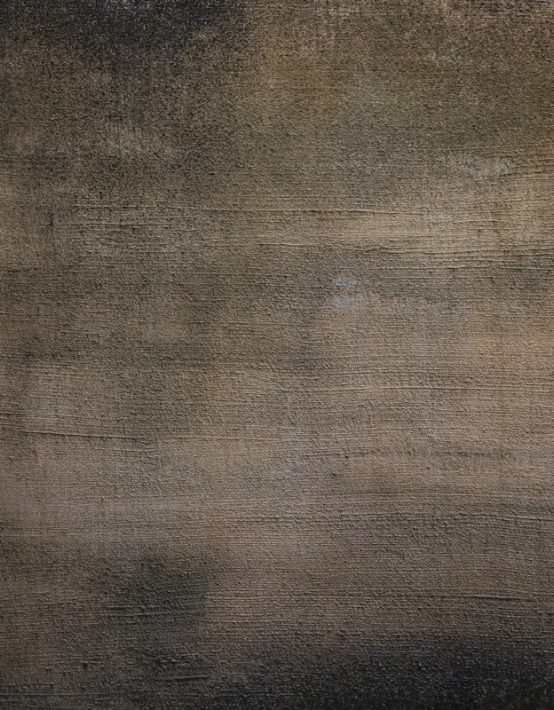
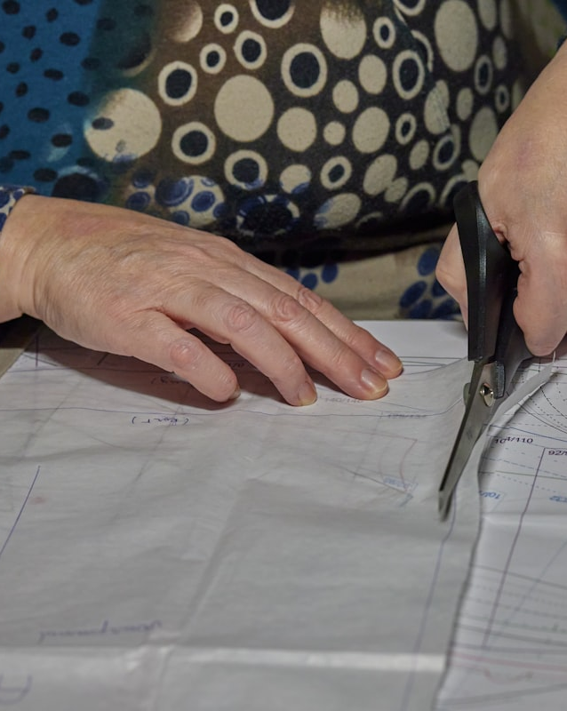
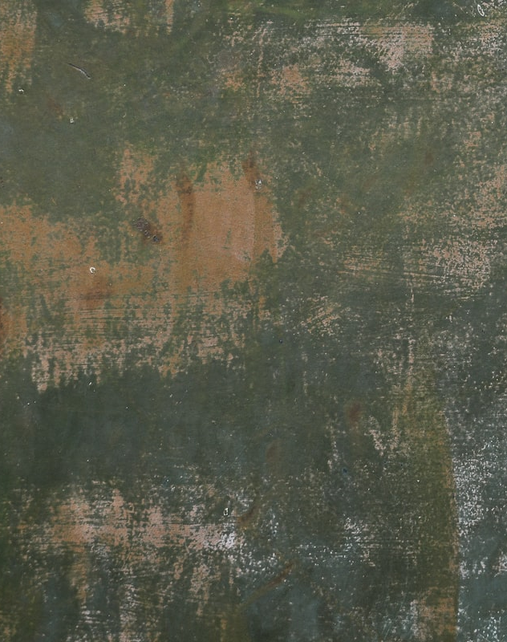
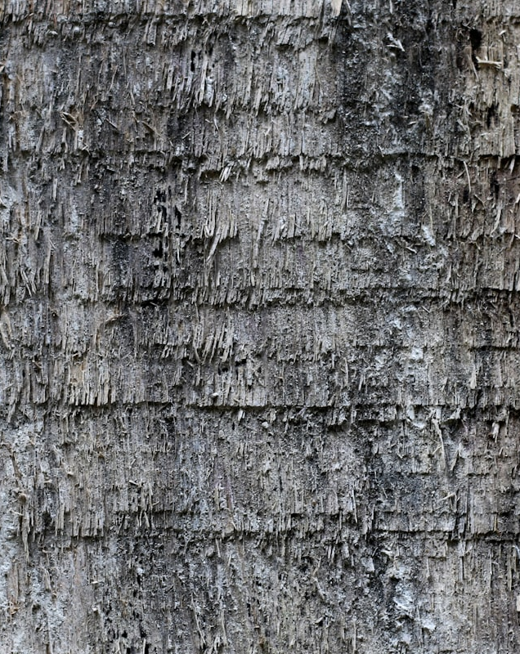
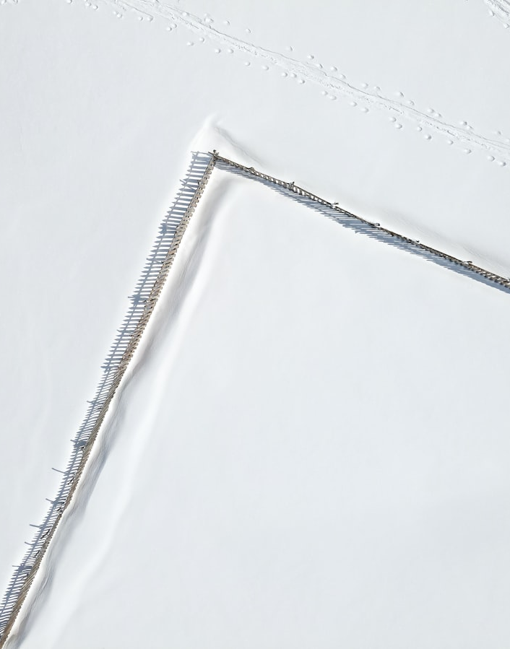
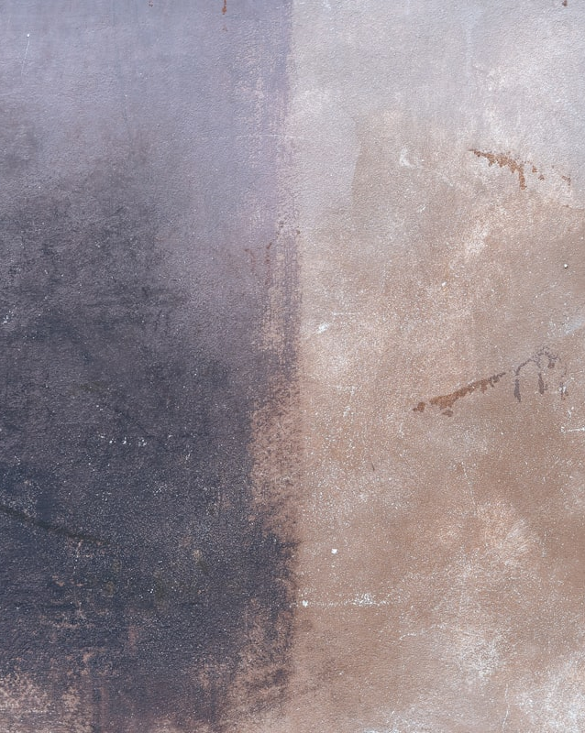
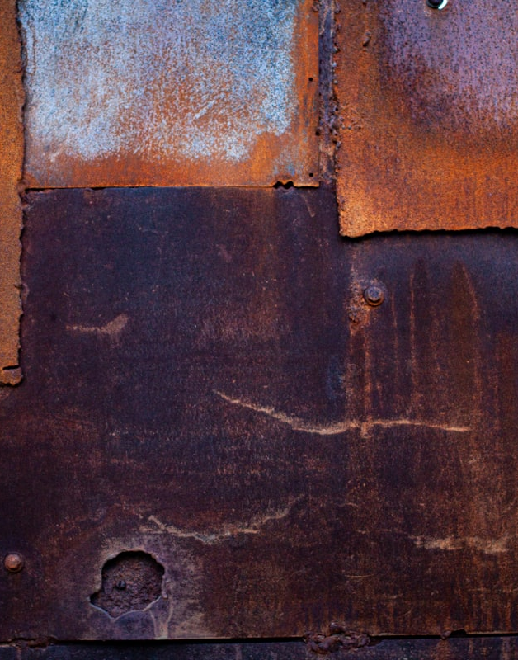
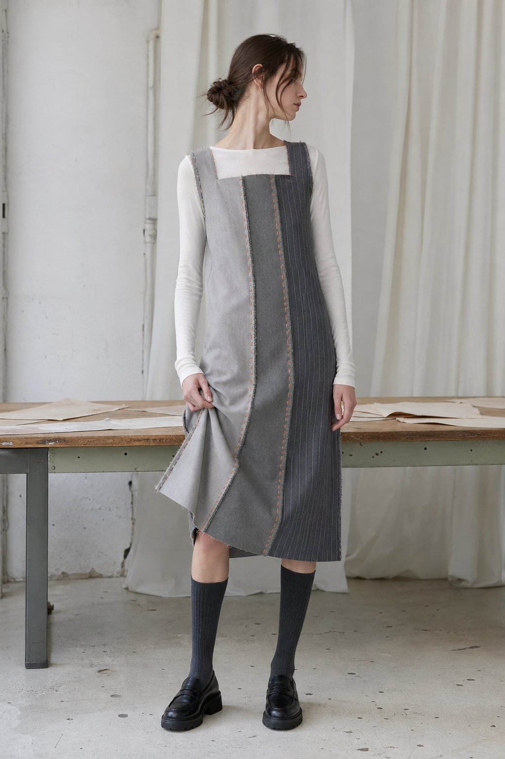
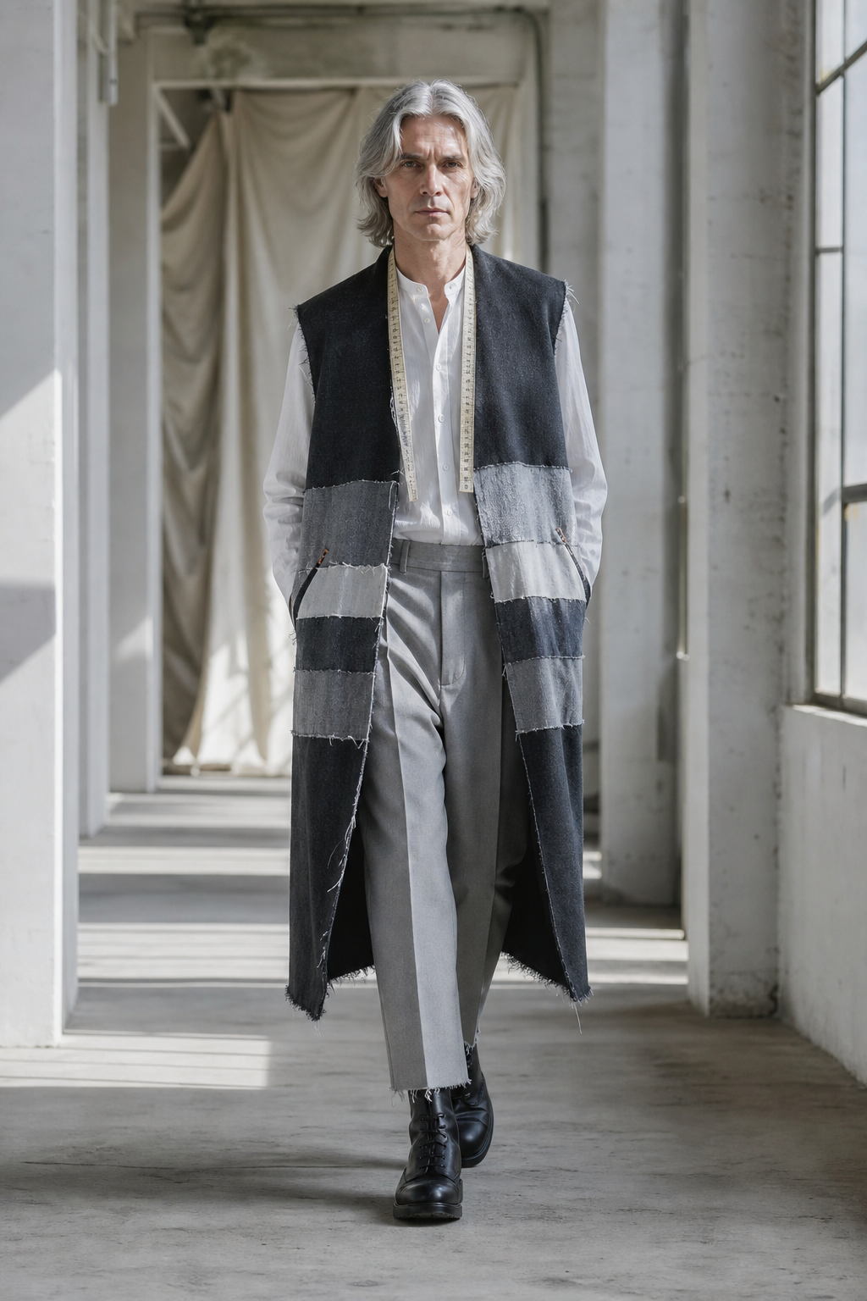
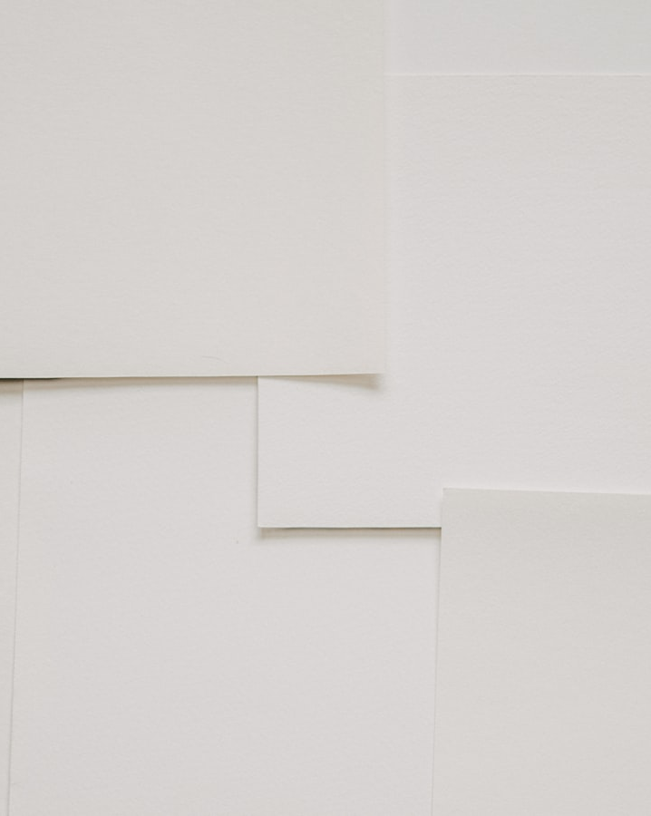
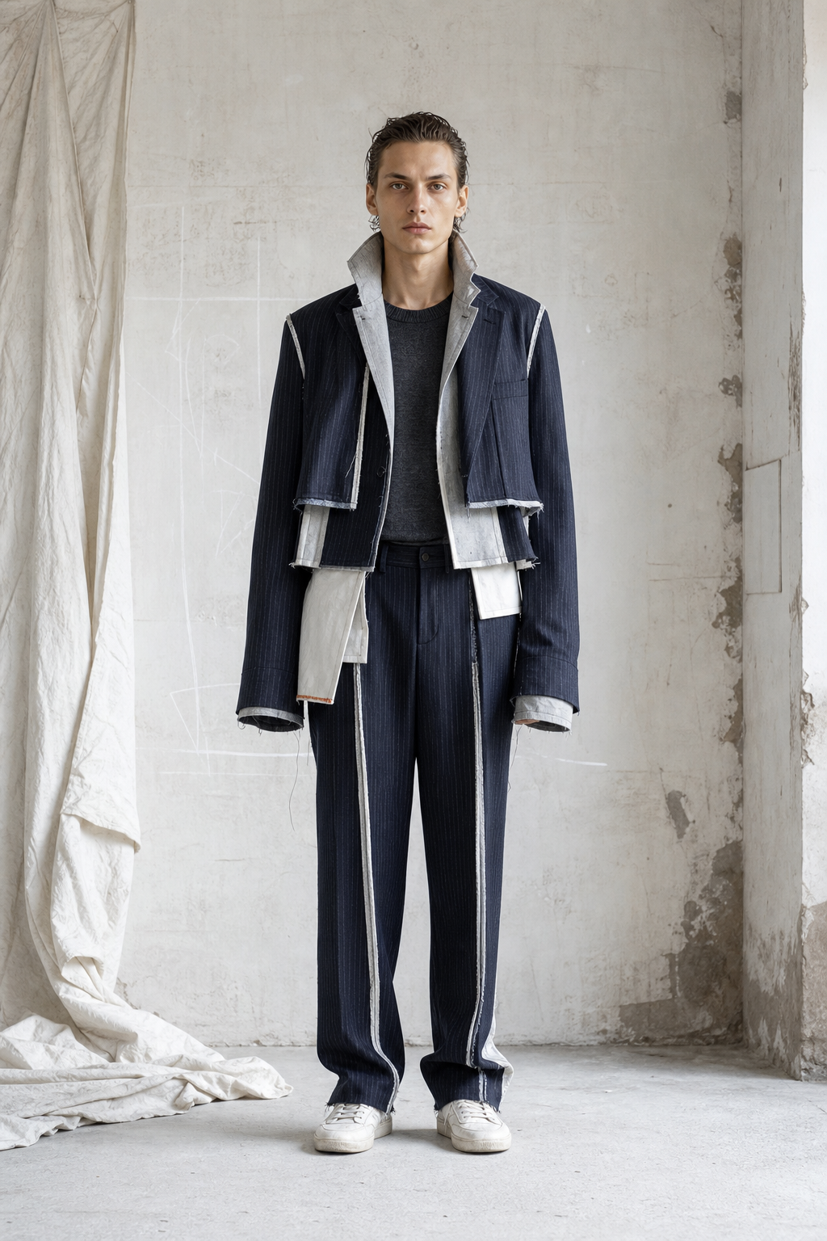
SEAM ALLOWANCE — mood
SPRING/SUMMER 2027

Slide 6

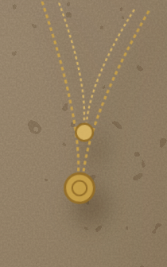










PALETTE
COLOUR STORY
Pearl Grey
CHALK
SEASONAL EN…
Chalk
SEASONAL ENTRY — PALE SUITING…
Flannel Ash
SEASONAL ENTRY — MARKING LAYE…
CORE CARRYOVER (~20% OF COLLE…
PEARL GREY
SEASONAL EN…
FLANNEL ASH
CORE CARRYO…
Charcoal
SLATE PINSTRIPE
SEASONAL EN…
Slate Pinstripe
CORE CARRYOVER (~15%) — DEEP…
SEASONAL ENTRY — BLUE-TINGED…
Anthracite Ink
CORE GROUNDING (~10%) — NEAR-…
CHARCOAL
CORE CARRYO…
walk the line, bone → espresso
ANTHRACITE INK
CORE GROUND…

Slide 7
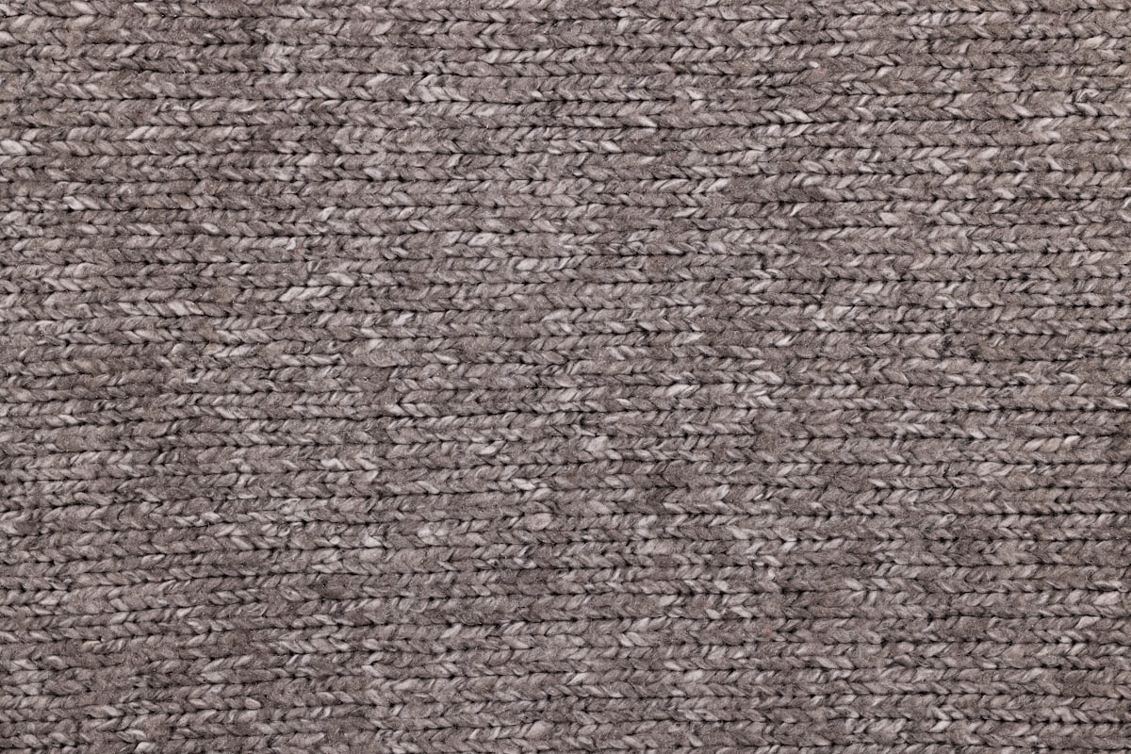
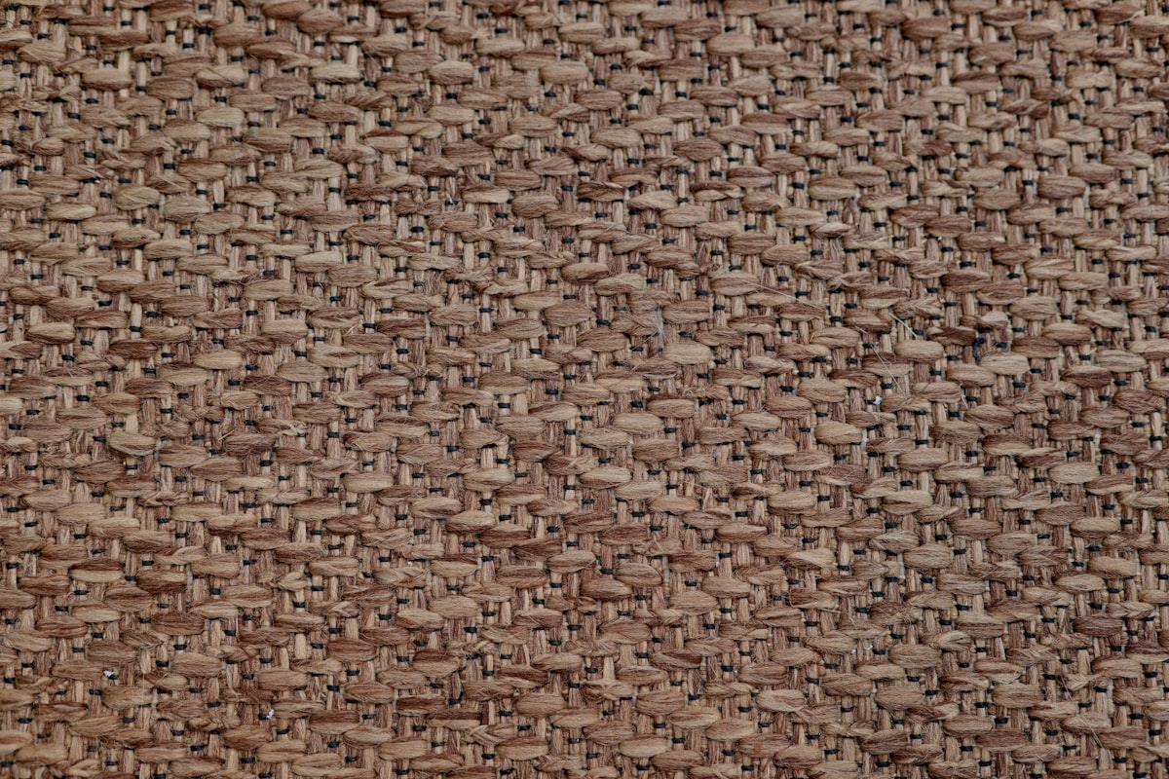




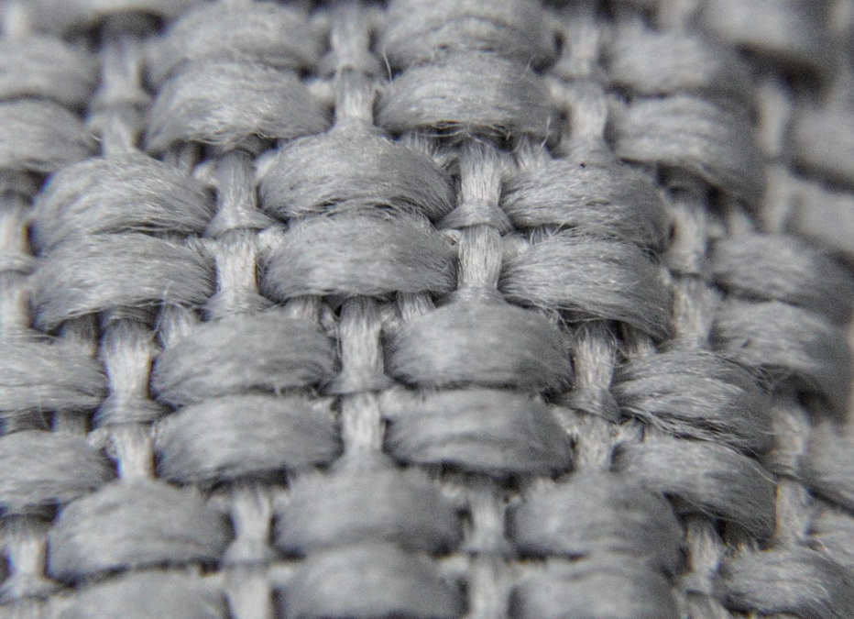
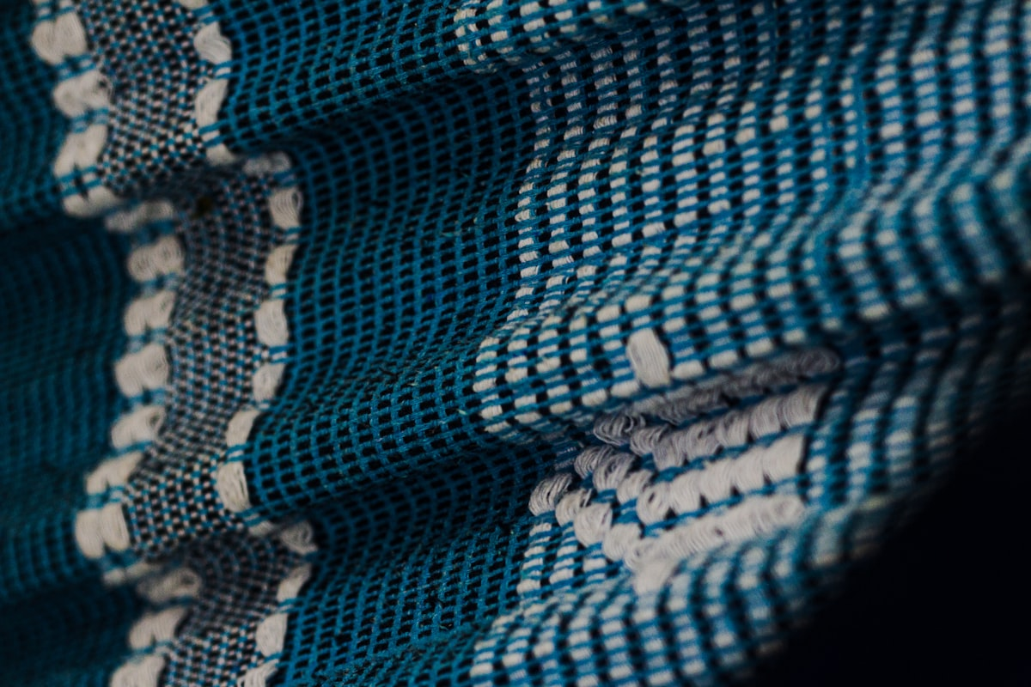






Fabric Library
HAND & WEIGHT
Dress: mixed reclaimed suiting wools, 240–300g/m, panels pinked and left raw, joined by 8mm running basting stitches in colorfast polyester thread; t…
Reclaimed Italian wool twill suiting, 260g/m, dry finish, half-canvassed with horsehair chest piece exposed; shirt in 120g/m compact cotton poplin; t…
Dress: mixed reclaimed suiting wools
Reclaimed Italian wool twill suiting
Reclaimed wool overcoat cloth, 420g/m, brushed melton finish; patchwork strips in mixed reclaimed suiting 240–300g/m, pinked raw edges overlapped and…
Reclaimed pinstripe wool suiting, 280g/m, constructed wrong-side-out with chalk cotton pocketing (150g/m) and weft-insertion fusible left exposed; sw…
Reclaimed wool overcoat cloth
Reclaimed pinstripe wool suiting
swatch, pin, repeat

Slide 8






THE LINE-UP
SILHOUETTES
N° 2
N° 4
N° 1
N° 3
walk order →

Slide 9
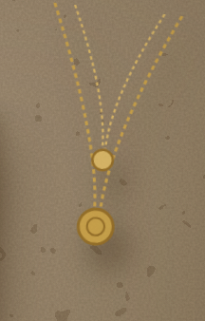


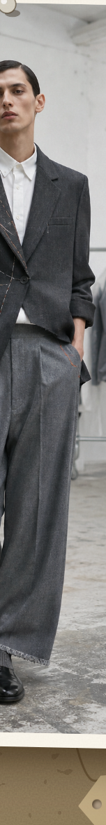
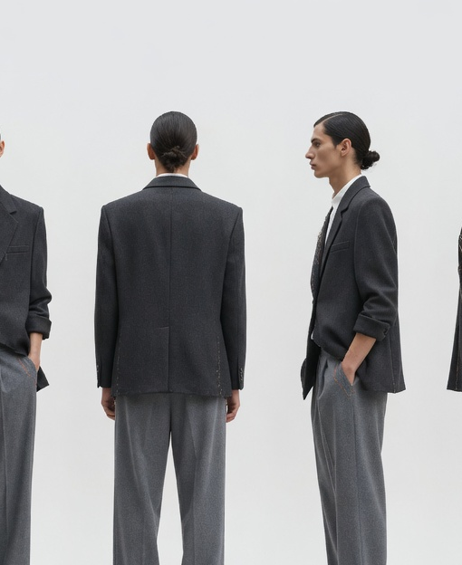




SPRING/SUMMER 2027
LOOK
N° 01
First Fitting
The opening statement: a single-breasted suit caught mid-fitting. A reclaimed charcoal blazer is worn with its right front panel unpicked and folded open so the floating half-canvas and chalk-marked chest piece are on the outside; one lapel is tacked back with orange basting stitches. Underneath, a sleeveless chalk poplin shirt, and full flannel-ash trousers whose hems are left raw and slowly fraying over polished derbies.
detail
Charcoal blazer over Chalk shirt, Flannel A…
First Fitting
FITTING NOTE

Slide 10






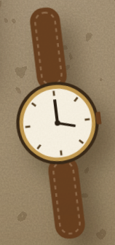

LOOK IN DETAIL
FIRST FITTING
CONSTRUCTION
Fabric
Reclaimed Italian wool twill suiting, 260g/m, dry finish, half-canvassed with…
every seam by hand
Seams
Flat-felled seams, bar-tacked stress points
Colourway
Charcoal blazer over Chalk shirt, Flannel Ash trousers, Anthracite Ink footwe…
Care
Dry clean recommended
First Fitting

Slide 11




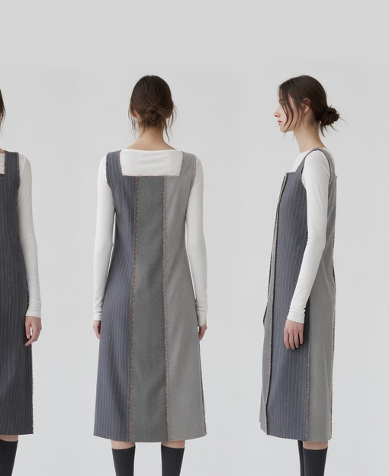




SPRING/SUMMER 2027
LOOK
N° 02
Basted Panels
The offcut look: a sleeveless column dress pieced entirely from reclaimed suiting panels — pearl grey, flannel ash and slate pinstripe — the panels not sewn shut but held with long, visible orange hand-basting stitches, seam allowances worn on the outside like piping. Layered over a chalk ribbed long-sleeve tee, it translates the deconstructed-suit language into a single lean line.
detail
Pearl Grey, Flannel Ash and Slate Pinstripe…
Basted Panels
FITTING NOTE

Slide 12


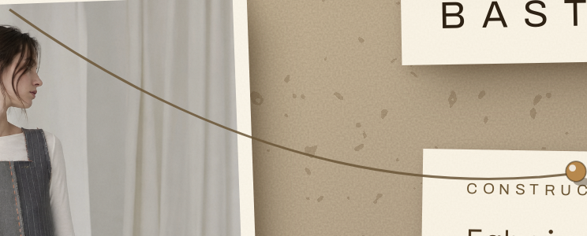




LOOK IN DETAIL
BASTED PANELS
CONSTRUCTION
Fabric
Dress: mixed reclaimed suiting wools, 240–300g/m, panels pinked and left raw,…
every seam by hand
Construction
Canvassed tailoring construction
Colourway
Pearl Grey, Flannel Ash and Slate Pinstripe panels over a Chalk tee; Charcoal…
Care
Dry clean recommended
Basted Panels

Slide 13



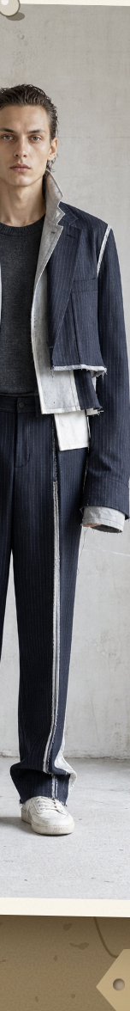
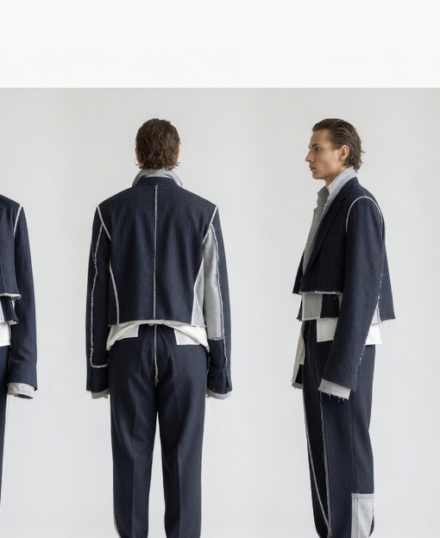



SPRING/SUMMER 2027
LOOK
N° 03
Inside-Out
The suit turned against itself: a cropped boxy jacket and straight trousers in slate pinstripe, constructed fully inside-out so the chalk cotton pocket bags, fusible interlining and internal felling become the visible surface. Worn over a charcoal merino crew with scuffed white sneakers, it is the collection's most literal read — the anatomy of a suit worn as the garment.
detail
Slate Pinstripe suit with Chalk pocketing a…
Inside-Out
FITTING NOTE

Slide 14
LOOK IN DETAIL
INSIDE-OUT
CONSTRUCTION
Fabric
Reclaimed pinstripe wool suiting, 280g/m, constructed wrong-side-out with cha…
every seam by hand
Construction
Canvassed tailoring construction
Colourway
Slate Pinstripe suit with Chalk pocketing and interlining exposed; Charcoal k…
Care
Dry clean recommended
Inside-Out

Slide 15



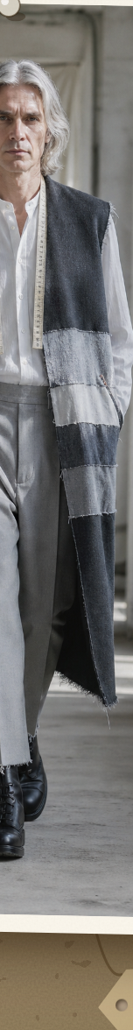
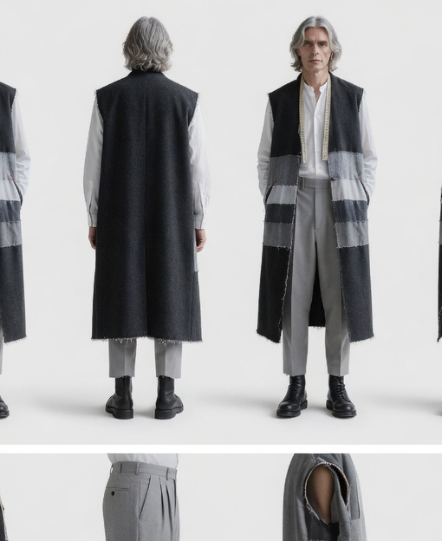



SPRING/SUMMER 2027
LOOK
N° 04
The Archive Coat
The closing silhouette and the campaign hero: a sleeveless longline topcoat in heavy anthracite overcoat cloth, its front panels banded with horizontal patchwork strips cut from every grey in the palette — the collection's offcuts archived onto one garment. Armholes and hem are left raw and fraying; a tailor's measuring tape hangs around the neck. Worn open over a chalk grandad shirt and pearl pleated trousers with heavy boot…
detail
Anthracite Ink coat banded with the full gr…
The Archive Coat
FITTING NOTE

Slide 16


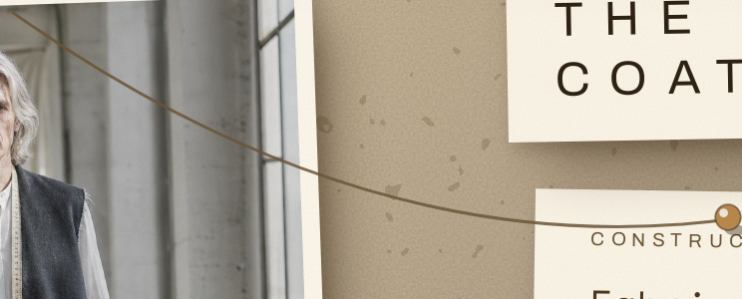


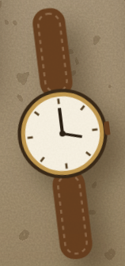

LOOK IN DETAIL
THE ARCHIVE COAT
CONSTRUCTION
Fabric
Reclaimed wool overcoat cloth, 420g/m, brushed melton finish; patchwork strip…
every seam by hand
Seams
Flat-felled seams, bar-tacked stress points
Finish
patchwork
Colourway
Anthracite Ink coat banded with the full grey band — Chalk, Pearl Grey, Flann…
Care
Dry clean recommended
The Archive Coat

Slide 17





SEAM ALLOWANCE — full line-up
SPRING/SUMMER 2027
N° 1
N° 2
N° 3
N° 4
fin.

Slide 18





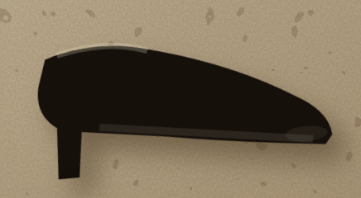

Spring/Summer 2027
COLOPHON
SEAM ALLOWANCE
SEAM ALLOWANCE · Spring/Summer 2027
Photo by Vitaly Gariev on Unsplash
Photo by Second Breakfast on Unsplash
Photo by Matthew Moloney on Unsplash
Photo by Marjan Taghipour on Unsplash
Photo by Kristina Tochilko on Unsplash
Photo by J Williams on Unsplash
Photo by Marek Levák on Unsplash
Photo by engin akyurt on Unsplash
with thanks — the atelier

