Slide 1

ba fashion design · final collection
tideline
what the sea leaves behind — worn, softened, and quietly beautiful.
Immy Calloway
fig. 00 — a returning tide
Notes:
Title. Open soft and atmospheric — introduce TIDELINE and the coastal-erosion concept.

Slide 2

concept
tideline began on a grey shore in winter — sea-glass smoothed by decades of water, rope frayed soft, driftwood pale as bone.
it is a resort collection about weathering: garments made to look worn-in and washed by the sea, in the colours the tide leaves behind.
— a study in erosion, softness and salt.
fig. 01 — weathered surface, studio wall
Notes:
Concept statement in the student's own voice, with one supporting texture study.

Slide 3







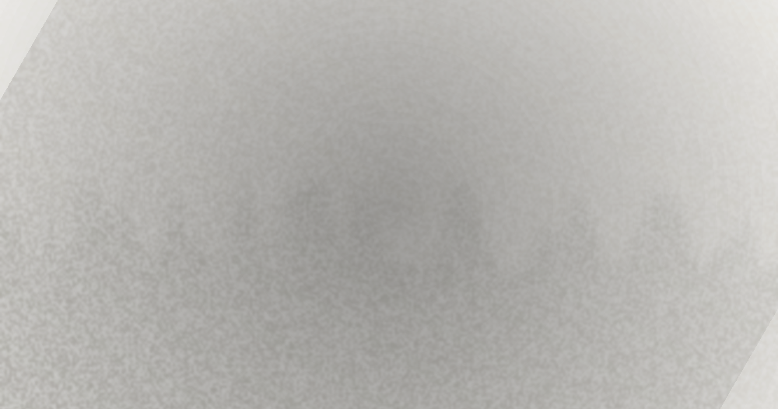
moodboard
fig. 02 — collected fragments
fig. 03 — rope
fig. 01 — tide pools
fig. 02 — sea-glass
fig. 04 — linen
fig. 05 — low horizon
fig. 06 — foam
fig. 07 — washed shore
fig. 08 — salt & wind
Notes:
The centrepiece — a dense, asymmetric moodboard of collected coastal fragments.

Slide 4
palette
the colours the tide leaves behind.
sea-glass
dry shore
wet rock
#9DC6C0
low tide
sea foam
washed coral
#E7DCC7
#3A4442
the surface
#6FA9A0
warm sand
#FBF9F4
#E4A88F
deeper water
soft ink
accent only
chalk paper
Notes:
The collection palette — soft sea-glass and sand, with a single washed-coral accent.

Slide 5




materials
honest, tactile, made to soften with wear.
fig. 01
fig. 02
fig. 03
fig. 04
washed linen
waxed cotton rope
recycled sea-glass
brushed wool gauze
garment-dyed, gently crumpled
drawcords & belts, hand-knotted
tumbled beads & buttons
open weave, salt-faded
Notes:
Material direction — four core fabrications, each chosen to weather softly.

Slide 6





silhouette · the line-up
fluid columns, dropped shoulders, tide-soft volume.
01
02
03
04
05
column
slip dress
cropped knit
+ wide trouser
waxed anorak
+ short
gauze midi
dress
cocoon coat
+ column
Notes:
Silhouette line-up — five croquis placeholders establishing the collection's proportion.

Slide 7
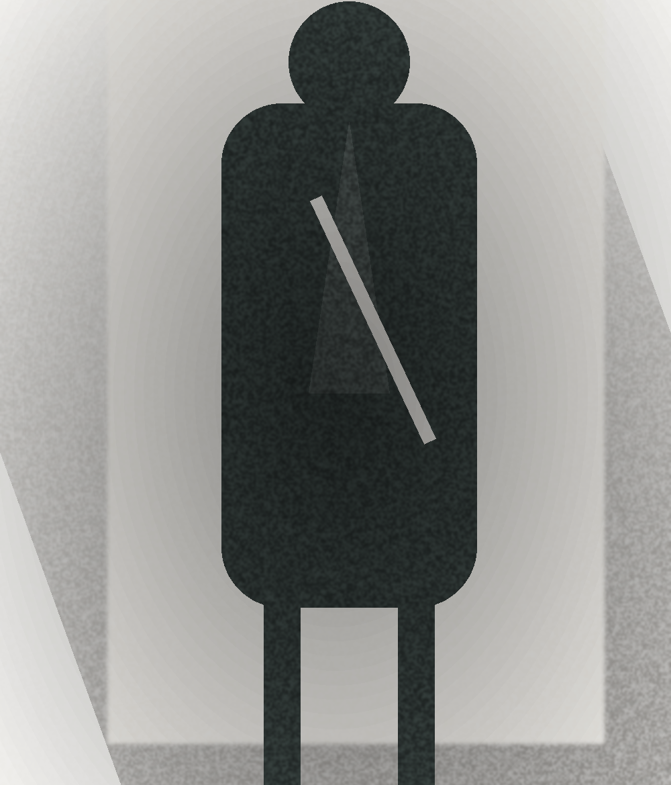
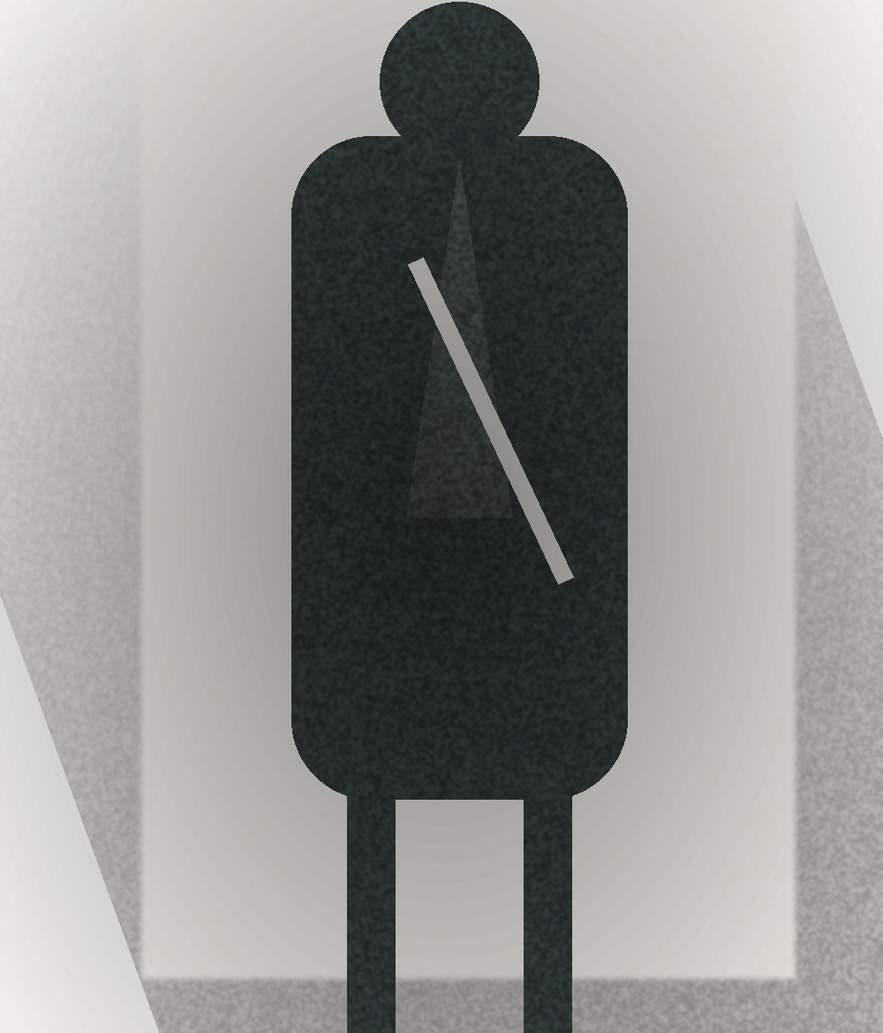
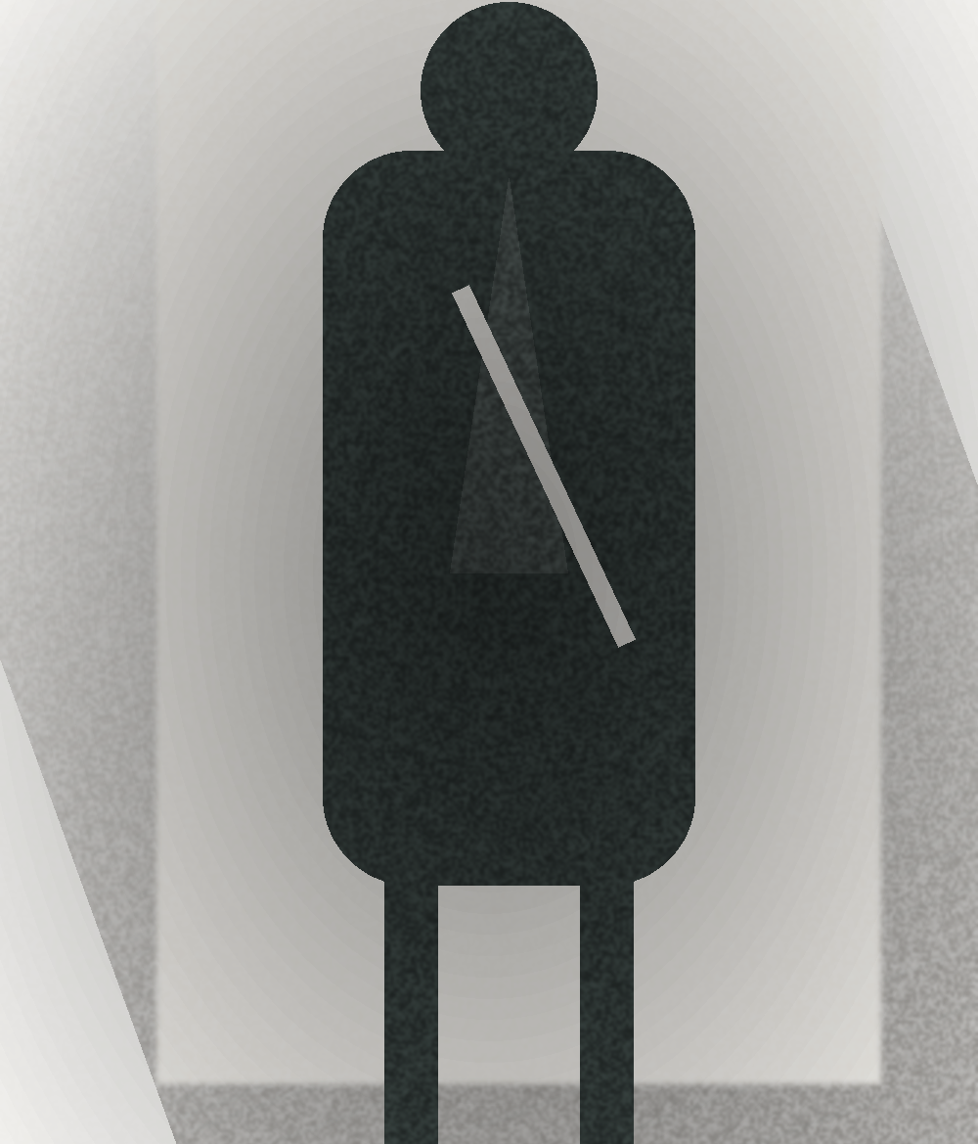
key looks
fig. 03 — resort, looks 01–03
look 01
look 02
look 03
driftwood
sea-glass
salt rope
Notes:
Key looks 01–03 — the opening resort statements in sea-glass and sand.

Slide 8

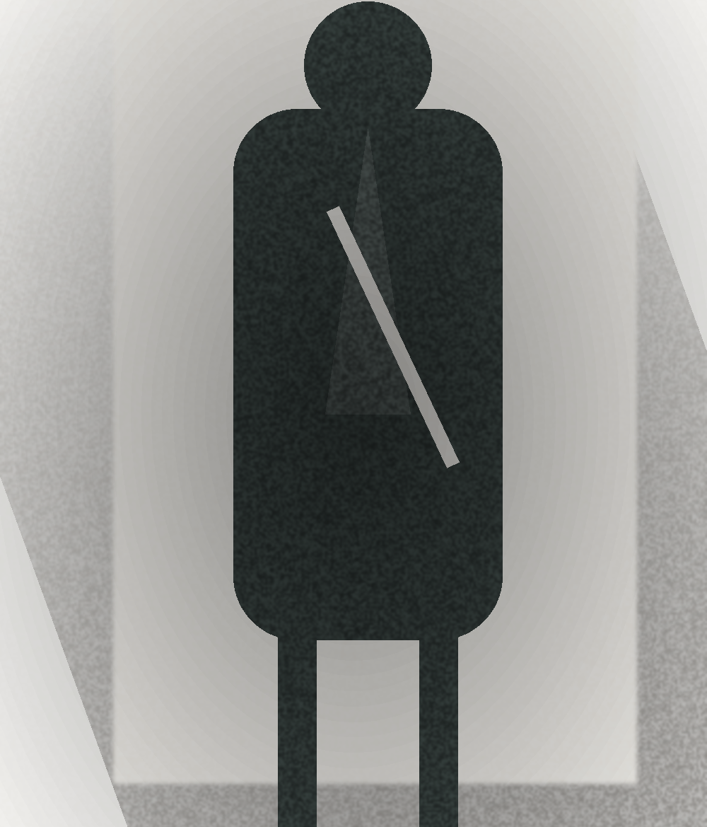

key looks
fig. 04 — resort, looks 04–06
look 04
look 05
look 06
foam
shale
low tide
Notes:
Key looks 04–06 — completing the six-look capsule.

Slide 9
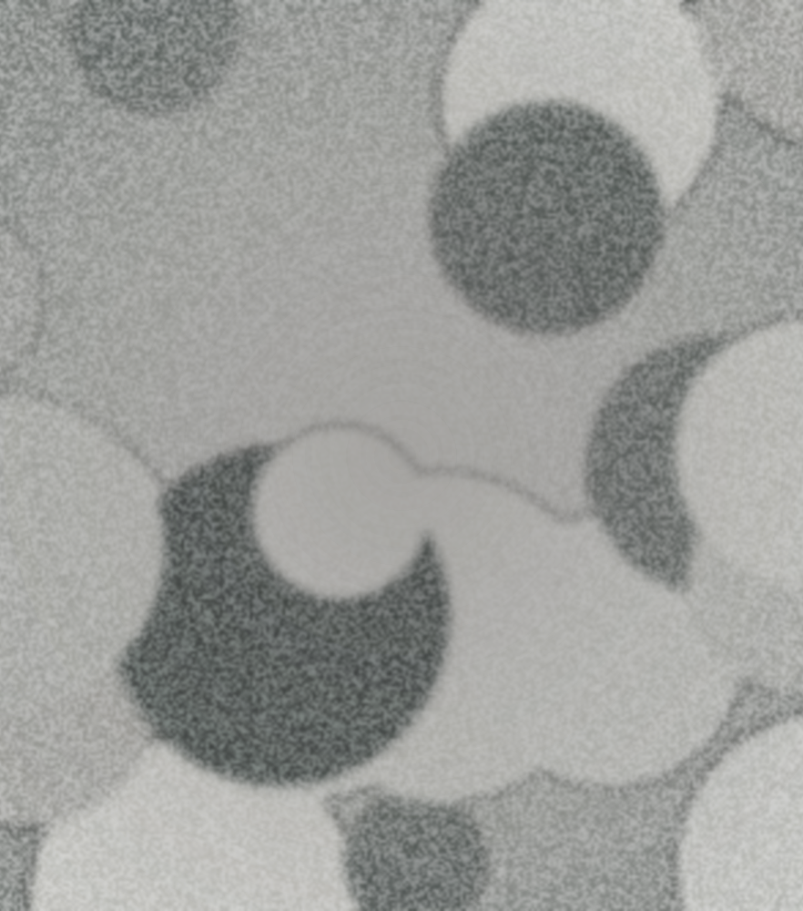




details & trims
the collection lives in its small things.
fig. 01
fig. 02
fig. 03
fig. 04
fig. 05
shell buttons
waxed rope drawcord
raw & rolled hems
sea-glass bead trim
visible whip-stitch
sanded, mismatched by hand
knotted, raw-cut ends
left to fray softly
tumbled, hand-sewn
contrast coral thread
Notes:
Details & trims — the hand-finished elements that carry the weathered story.

Slide 10
range plan
six looks · resort · spring delivery.
look | dresses | knitwear | outerwear | separates
01 · driftwood | tideline slip | — | — | wrap skirt
02 · sea-glass | — | open cardigan | — | wide trouser
03 · salt rope | — | — | waxed anorak | rope-belt short
04 · foam | gauze midi | rib tank | — | —
05 · shale | — | brushed pullover | — | linen trouser
06 · low tide | column dress | — | cocoon coat | —
— pieces read across each look; a personal, hand-drawn plan.
Notes:
Range plan — the six looks mapped across piece types, student range-plan style.

