Slide 1

PORTFOLIO / 2026
R.
OKAFOR
MENSWEAR · GRADUATE PORTFOLIO 2026
Notes:
Cover. Open confidently: 'I'm R. Okafor, a menswear designer. This portfolio is where tailoring meets utility.' Hold a beat on the name, then move.

Slide 2
01
I design menswear where tailoring and utility meet — garments with the discipline of a suit and the honesty of workwear.
DESIGNER
STATEMENT
My work starts on the stand and ends in the pattern. I build from function — load-bearing seams, honest fastenings, cloth chosen for how it moves — then cut with the precision of bespoke. Concrete greys and cobalt run through every collection: a personal, architectural palette that treats a jacket as structure, not decoration.
Notes:
Statement. Deliver this as your thesis in one breath, then expand: 'Every project you'll see is tailoring reasoned from utility.'

Slide 3
02 / SKILLS & TOOLS
MAKING & DIGITAL
01
02
03
04
PATTERN CUTTING
BESPOKE TAILORING
DRAPING
CLO3D
Flat & tailored blocks
Hand-finished construction
On-the-stand development
Digital sampling & fit
05
06
07
08
ILLUSTRATOR
MACHINE KNIT
TEXTILE DEV
PHOTOSHOP
Flats, tech packs, print
Stoll / domestic gauge
Sourcing & finishing
Boards & lookbook craft
Notes:
Skills. Don't read the grid aloud — group it: 'hand skills on the left, digital on the right; I move between the stand and the screen.'

Slide 4


03 / PROJECT A
SUBSTRATE
BRIEF Deconstructed tailoring rebuilt on workwear architecture.
PROCESS toile / detail / cloth
CONCEPT & PROCESS
SUBSTRATE strips a two-piece suit back to its load paths, then rebuilds it in cotton canvas and wool twill. Bellows pockets and taped seams are cut with bespoke geometry — utility detailing held to a tailoring tolerance.
Toile 03: chest-piece reworked as an external yoke
Seam-taped canvas replaces fusible interlining
Cobalt bar-tacks mark every stress point
Notes:
Project A — CONCEPT. Point at the detail tile first: 'this is where it started — a workwear pocket cut with a tailor's seam allowance.' Then the cloth: 'wool twill over cotton canvas — structure without fusing.' Land the line: 'the whole suit is reasoned from that one join.'

Slide 5

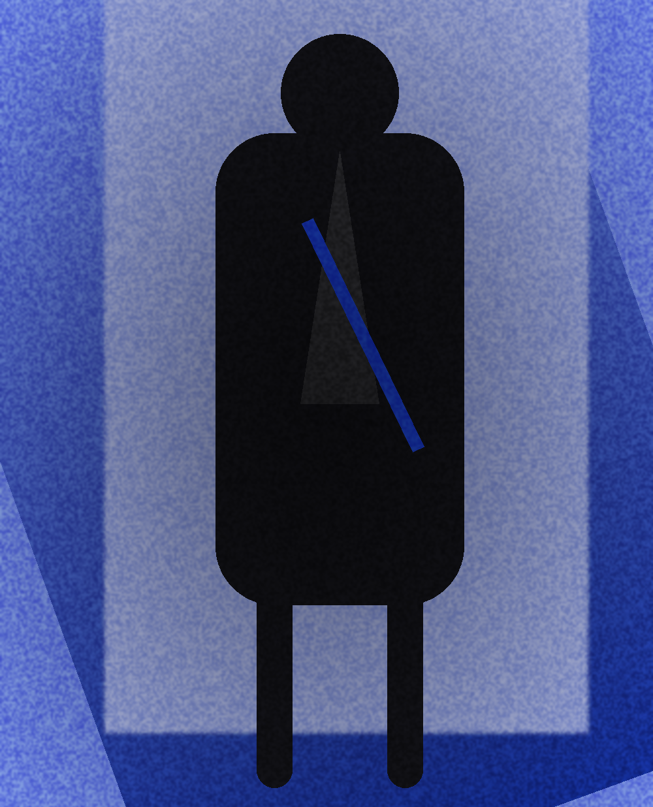

03 SUBSTRATE — FINAL LOOKS
PROJECT A · LOOKS 01–03
01
02
03
Three-look tailoring capsule: canvas overshirt, deconstructed two-piece, taped-seam trouser. Wool twill / cotton canvas / cobalt hardware.
Notes:
Project A — LOOKS. Walk left to right. Look 01: 'the overshirt carries the suit's shoulder line.' Look 02: 'the full two-piece — note the external chest yoke.' Look 03: 'trouser closes the story — taped seams, no lining.' Invite the eye to the cobalt bar-tacks on each.

Slide 6


04 / PROJECT B
GREYWORK
BRIEF Machine-knit menswear in a concrete palette.
PROCESS toile / detail / cloth
CONCEPT & PROCESS
GREYWORK translates the SUBSTRATE tailoring language into knit. Full-gauge Stoll panels are engineered with integral pockets and ribbed load seams, so a knitted jacket holds a tailored shoulder without a single cut-and-sew step.
Fully-fashioned panels — zero cut waste
Tuck-stitch ribs engineered as structural seams
Tonal concrete greys, single cobalt intarsia mark
Notes:
Project B — CONCEPT. Start with the texture board: 'same architecture, new material — knit.' Then the swatch: 'fully-fashioned on the Stoll, so the panel IS the pattern.' Key line: 'the shoulder is knitted in, not sewn on.'

Slide 7
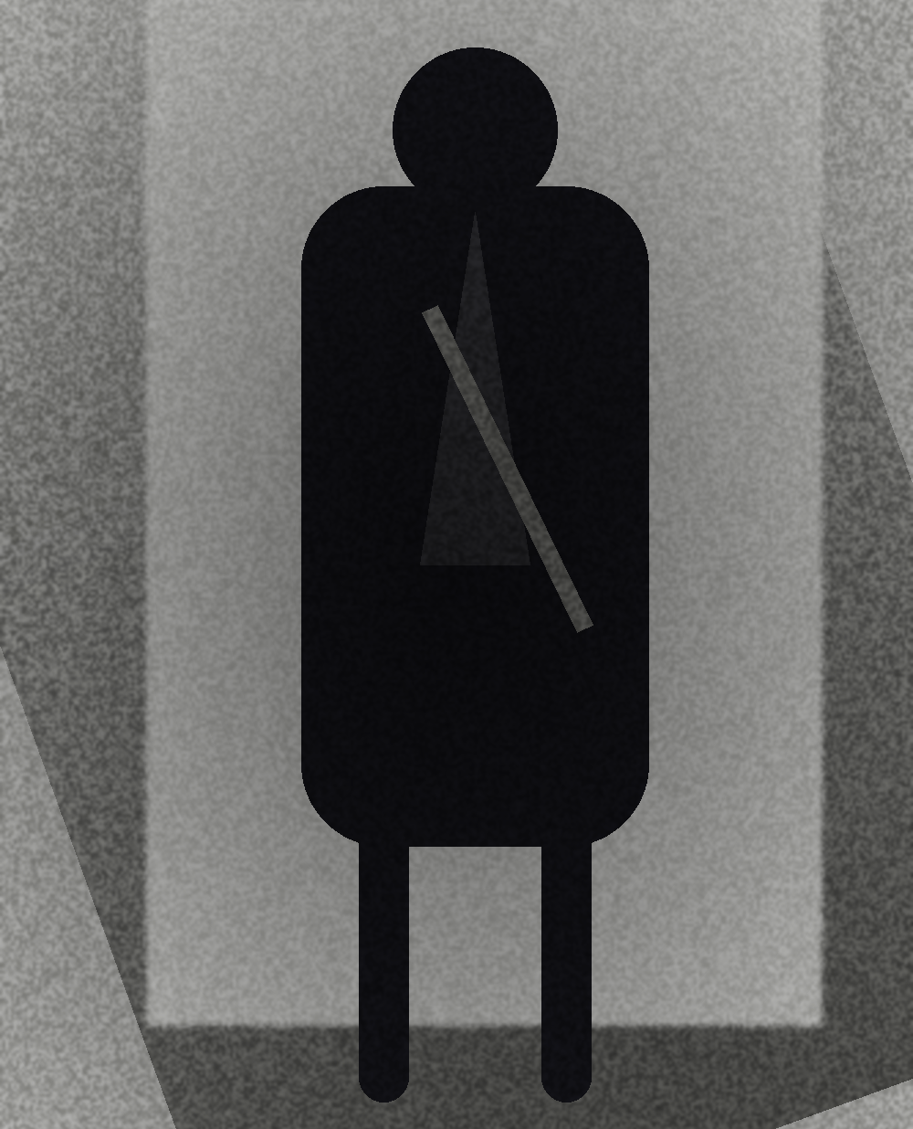
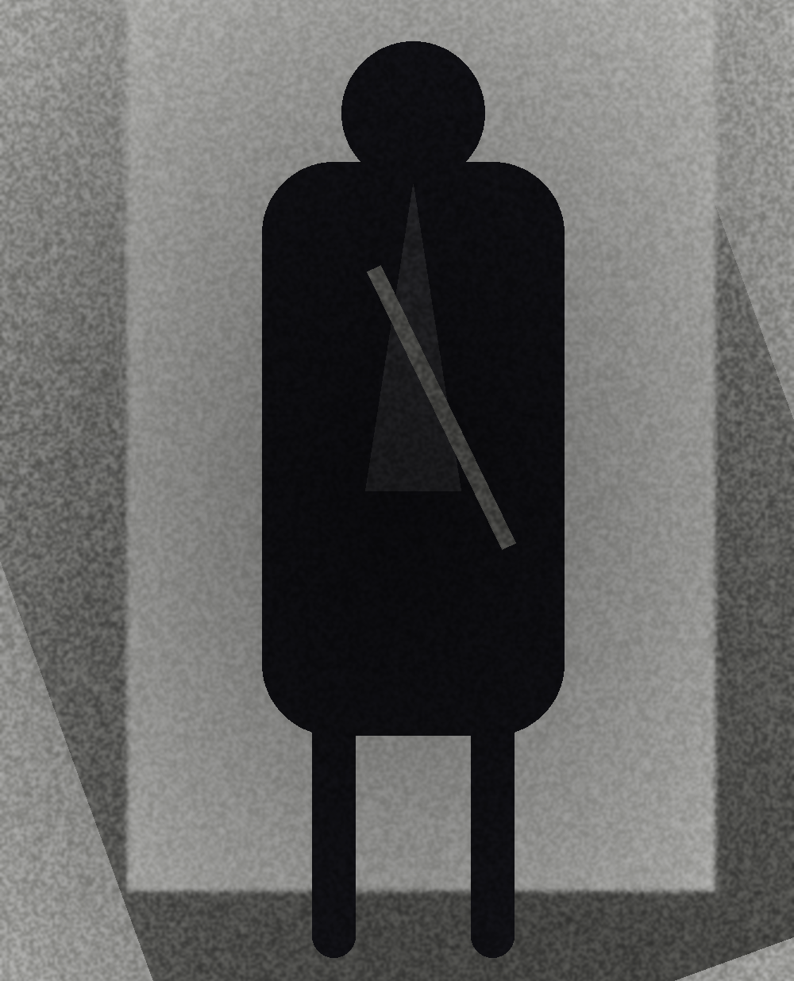

04 GREYWORK — FINAL LOOKS
PROJECT B · LOOKS 01–03
01
02
03
Knitwear trio: fully-fashioned zip-through, ribbed tailored cardigan, engineered-panel crew. Concrete-grey merino with cobalt intarsia detail.
Notes:
Project B — LOOKS. Look 01: 'the zip-through — that shoulder is fully fashioned.' Look 02: 'cardigan cut like a jacket, entirely in knit.' Look 03: 'the crew shows the integral pocket.' Point out the single cobalt mark that ties it to SUBSTRATE.

Slide 8


05 / PROJECT C
COBALT FIELD
BRIEF Technical outerwear meets tailored structure.
PROCESS toile / detail / cloth
CONCEPT & PROCESS
COBALT FIELD takes the collection outdoors. A three-layer field jacket is patterned with tailoring darts and articulated elbows, bonded in a matte cobalt membrane. Weather performance, cut like a coat — the thesis at scale.
Articulated sleeve drafted from a tailored two-piece
Bonded seams — waterproof, no topstitch
Storm-cobalt shell over concrete fleece lining
Notes:
Project C — CONCEPT. The scene board sets mood: 'this one leaves the studio.' The membrane swatch: 'matte cobalt, three-layer, fully bonded.' Land it: 'a technical shell drafted with a tailor's two-piece sleeve — the whole thesis in one garment.'

Slide 9



05 COBALT FIELD — FINAL LOOKS
PROJECT C · LOOKS 01–03
01
02
03
Outerwear finale: bonded field jacket, articulated cobalt shell, layered storm parka. Three-layer membrane over concrete fleece — the graduate look.
Notes:
Project C — LOOKS. This is the finale, slow it down. Look 01: 'the field jacket — tailored darts under a bonded shell.' Look 02: 'articulated cobalt shell, full range of movement.' Look 03: 'the storm parka closes the show.' End on: 'utility and tailoring, finally the same garment.'

Slide 10


06 / TECHNICAL SAMPLES
FLATS & PATTERNS
FLAT 01 — FIELD JACKET, FRONT
FLAT 02 — TROUSER
FABRIC SAMPLES
WOOL TWILL
320 GSM
RIP-STOP
COTTON
Every flat drafted in Illustrator from a graded block; samples cut and seam-tested before toile.
Notes:
Technical samples. Show the rigour: 'these are my working flats — drafted from graded blocks, not traced.' Point at the bellows pocket and the taped-seam note.

Slide 11
07 / EXPERIENCE & EDUCATION
THE ROUTE HERE
2026
GRADUATE COLLECTION — 'SUBSTRATE'
BA Menswear final collection · shown on-schedule
2025
KNITWEAR ASSISTANT
John Smedley — engineered fully-fashioned panels
2024
DESIGN INTERN
Craig Green — utility outerwear development
2023
PATTERN-CUTTING PLACEMENT
Anderson & Sheppard, Savile Row — bespoke drafting
2022–26
BA (HONS) MENSWEAR
Central Saint Martins — First Class (predicted)
Notes:
Timeline. Read it top-down, most recent first: 'the collection you just saw sits on four years of tailoring apprenticeship — Savile Row pattern-cutting through to Craig Green utility.'

Slide 12
CONTACT / LET'S WORK
R. OKAFOR
EMAIL r.okafor.studio@email.com
PORTFOLIO okafor.studio
BASED London, UK
MOBILE +44 7700 900 118
MENSWEAR · GRADUATE PORTFOLIO 2026
Notes:
Contact. Close with intent: 'I'm looking for a menswear design assistant role. Everything's on the portfolio site — thank you.' Leave the name up.

